Slide 1
Currency Site
(User Interface project)
Marios Pafitis
Leonidas Achilleos

Slide 2
General Information
Website Name: AntiScammer
Technologies: HTML, CSS, JavaScript, Bootstrap 4, Animate.css
Main Idea:
One of the most frustrating things that can happen when you go in a trip, is having to exchange money. Especially, when you have to think about the exchange rates and the commission.
BORING!
FRUSTRATING!
TIME CONSUMING!
But, have no worries. We are here for you. Through our website you can check whether the rate is good enough. And if it is not, we will show you the address of the closest ones to you. And all that with a dose of humor.

Slide 3
Usage
Steps:
Choose the currency of your money
Choose the currency of the country you are in
Ask them how much they “sell” you the currency that you want and insert it on the website
That’s all. You already have the result, and you can decide whether you should go to another place (maybe one of the ones we suggested) or not.
Extra Functionalities:
The user can report the Exchange Place in order to prevent other users of our website to go there.
The user can remember (like) places that have good exchange rate.

Slide 4
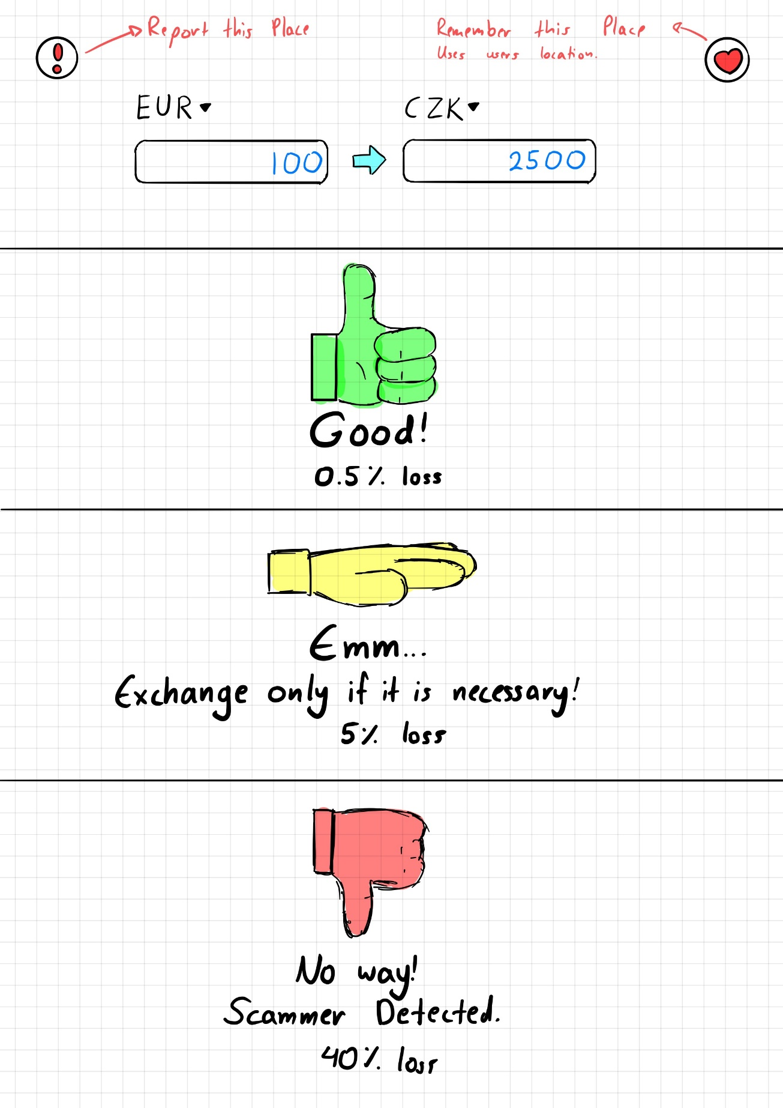
Prototype 1

Slide 5
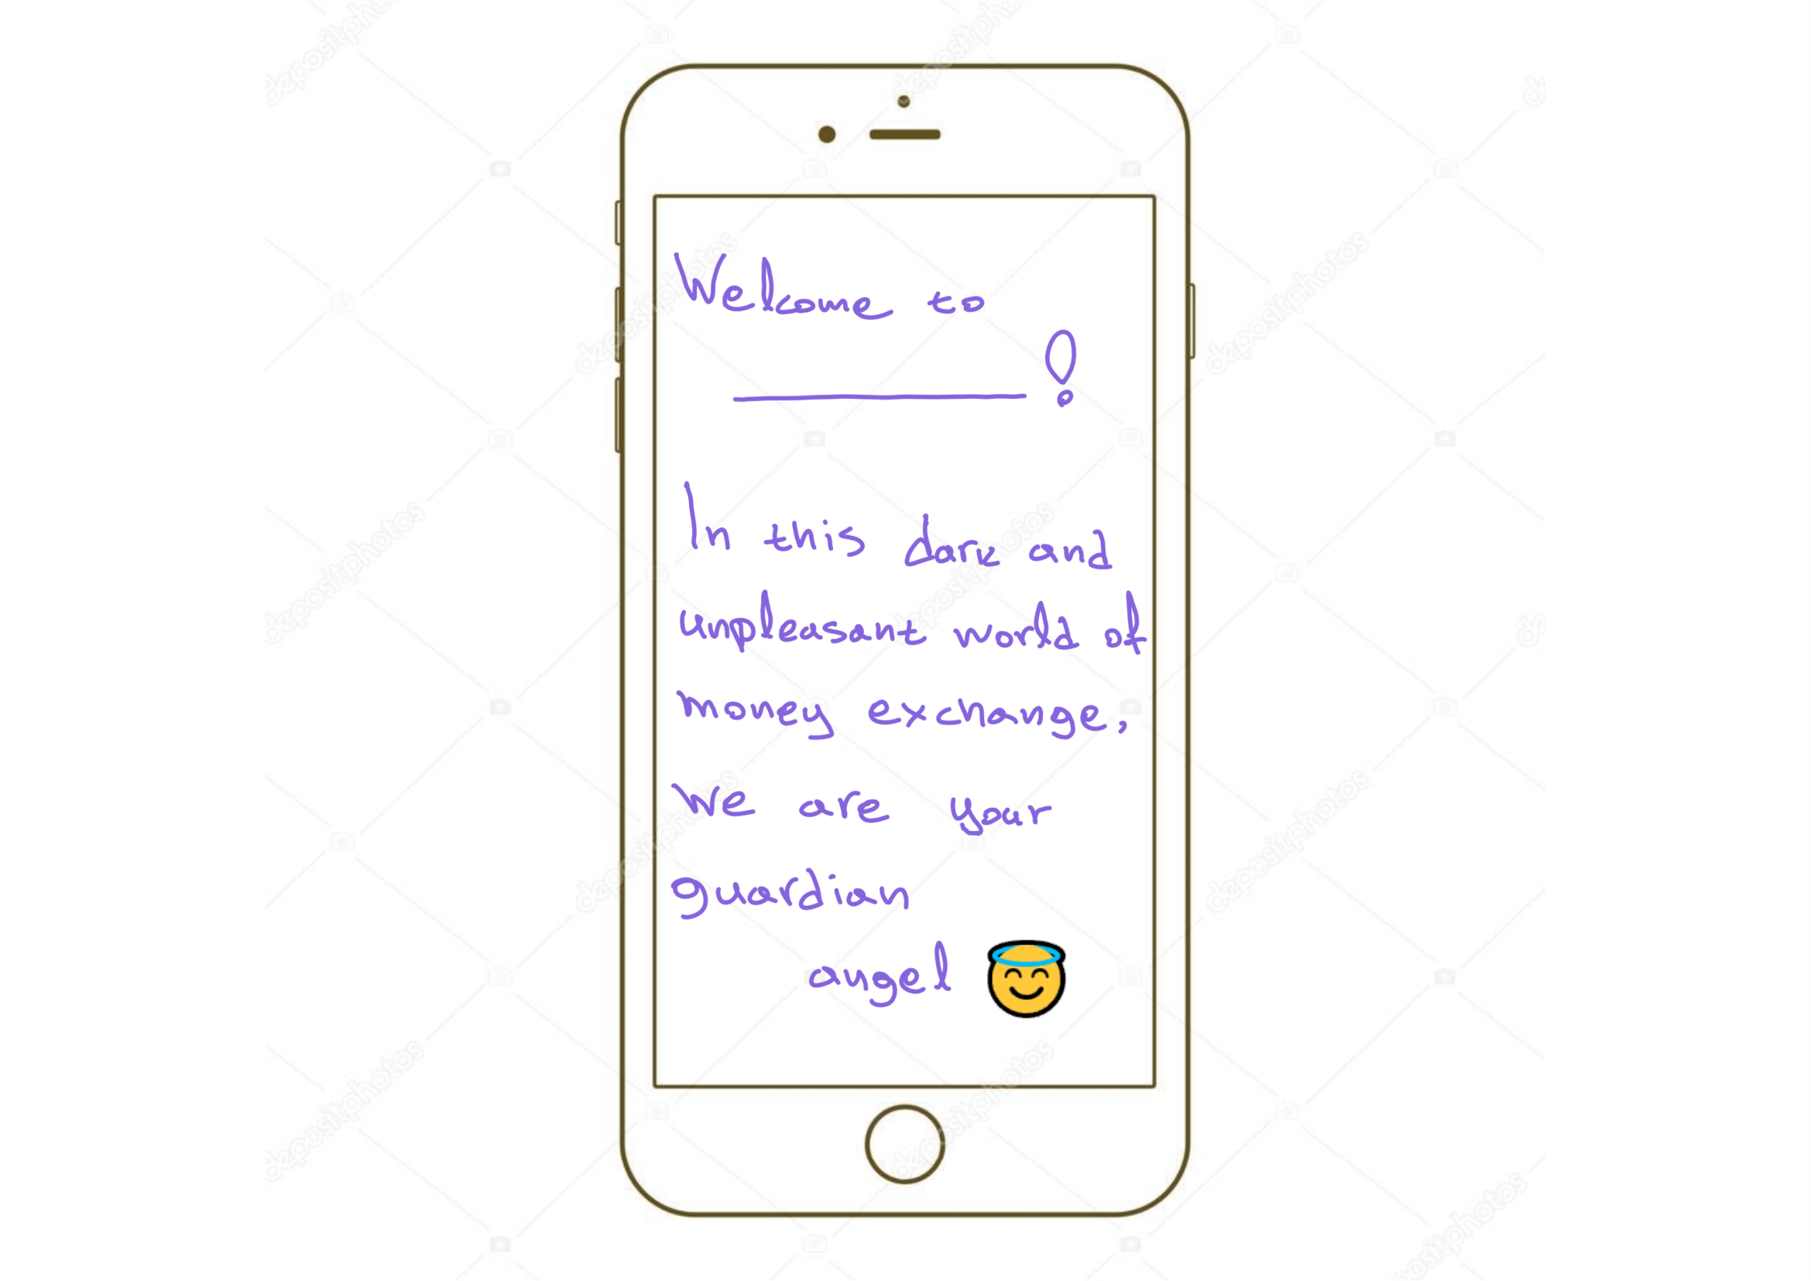
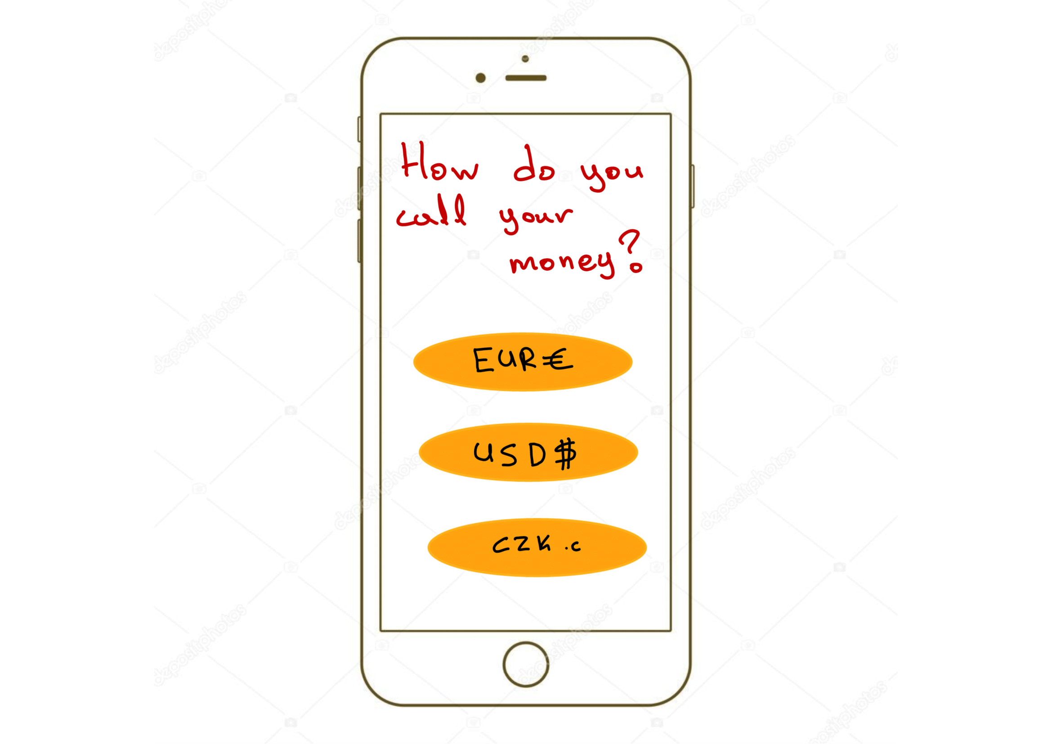
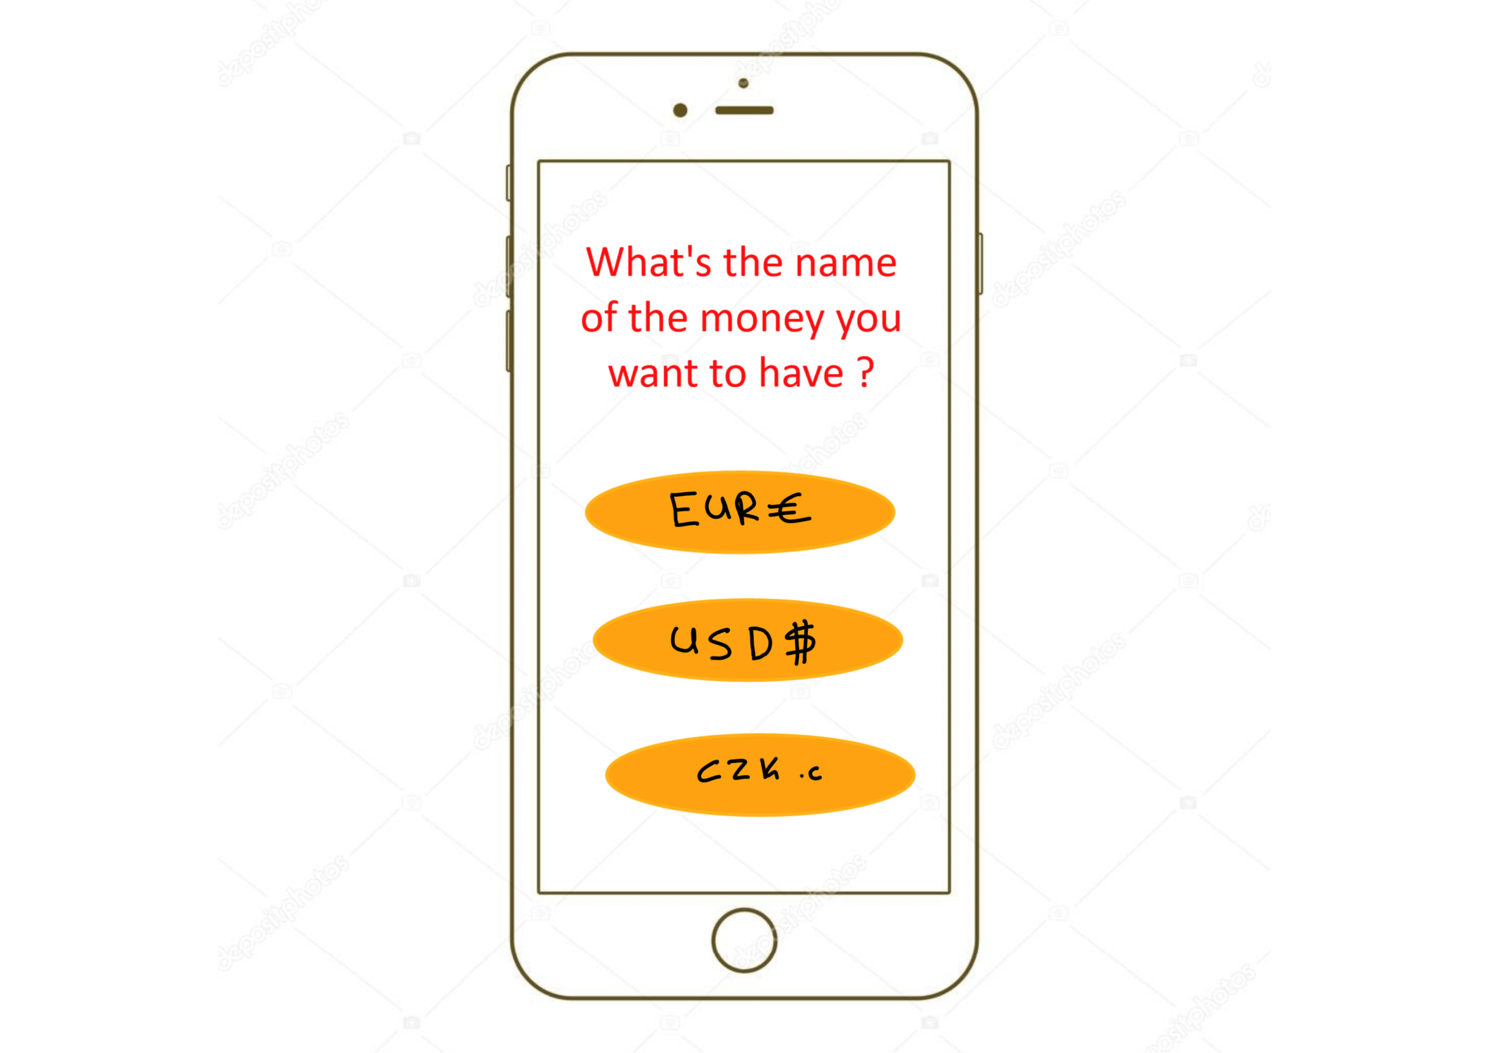
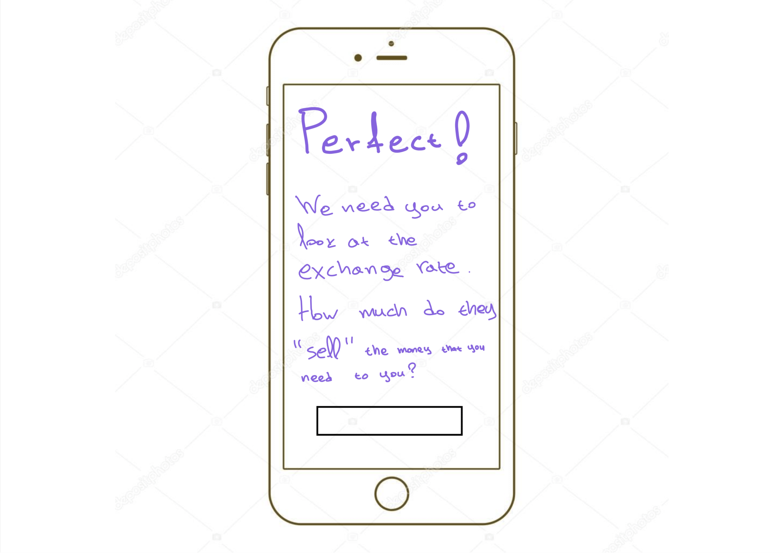
Prototype 2

Slide 6
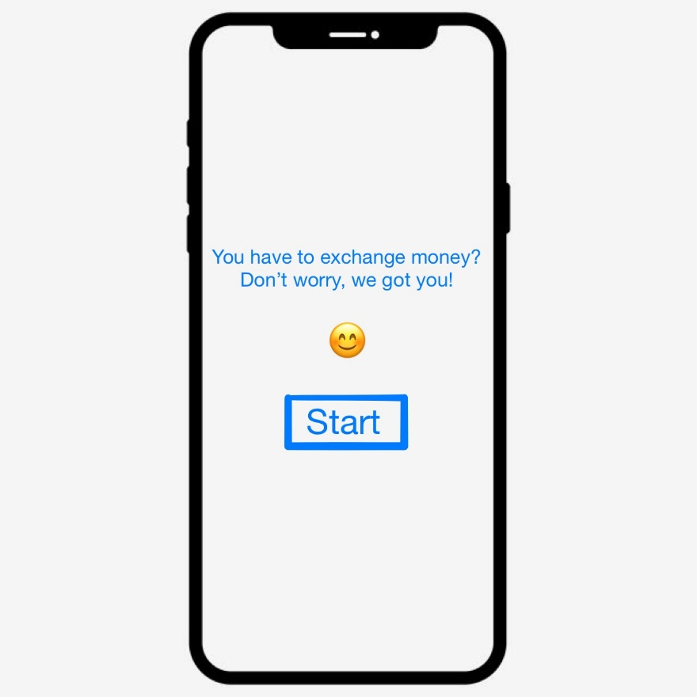
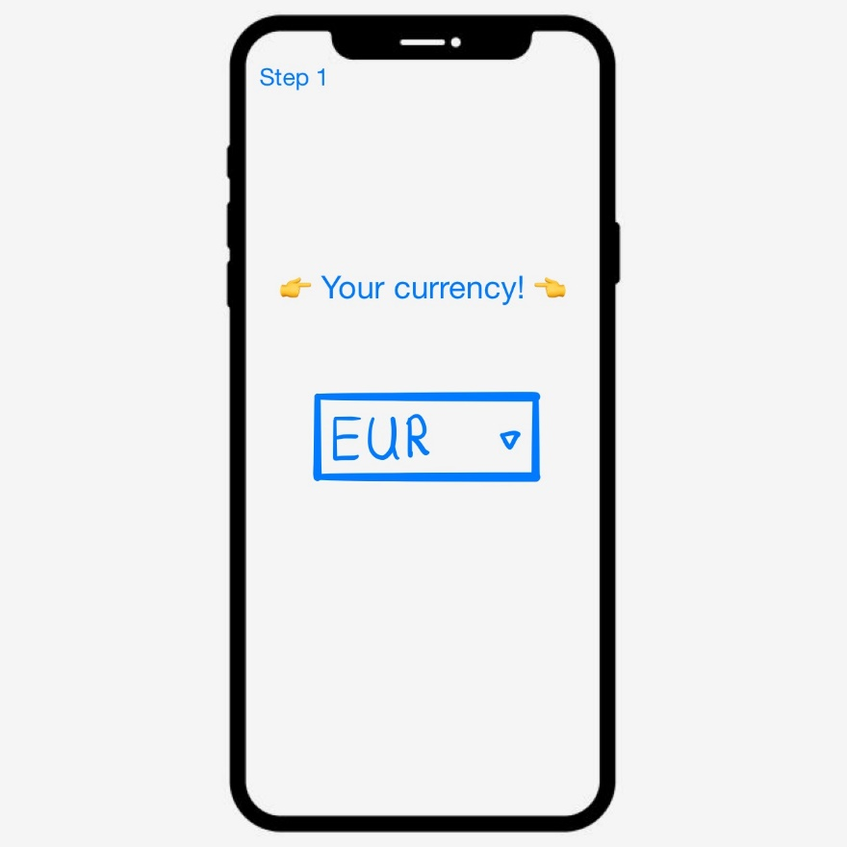
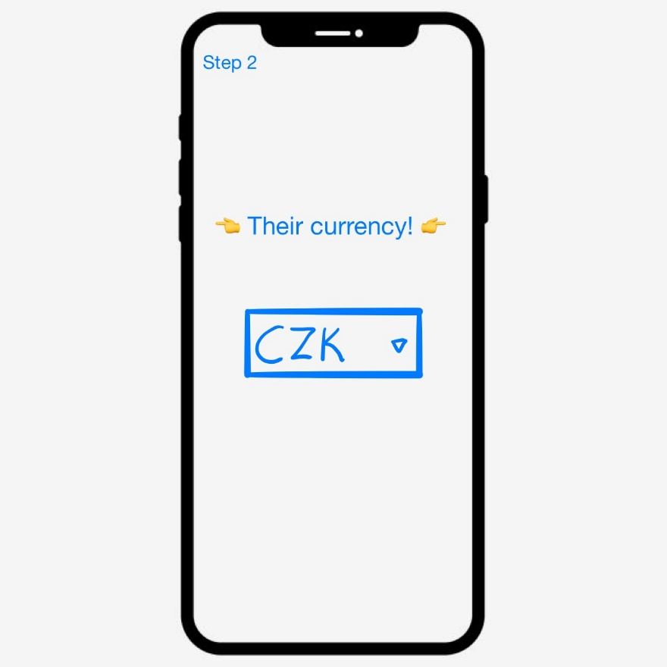
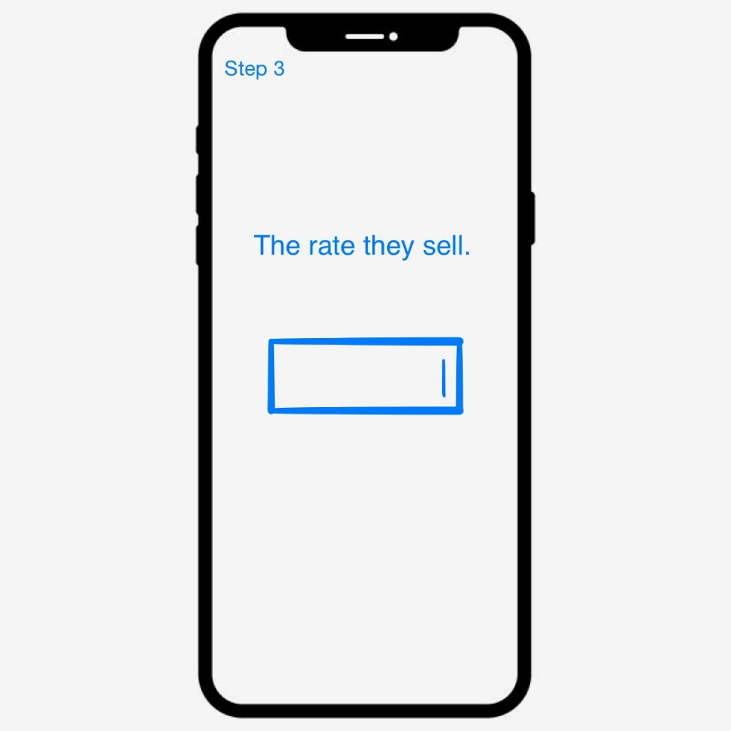
Prototype 3

Slide 7
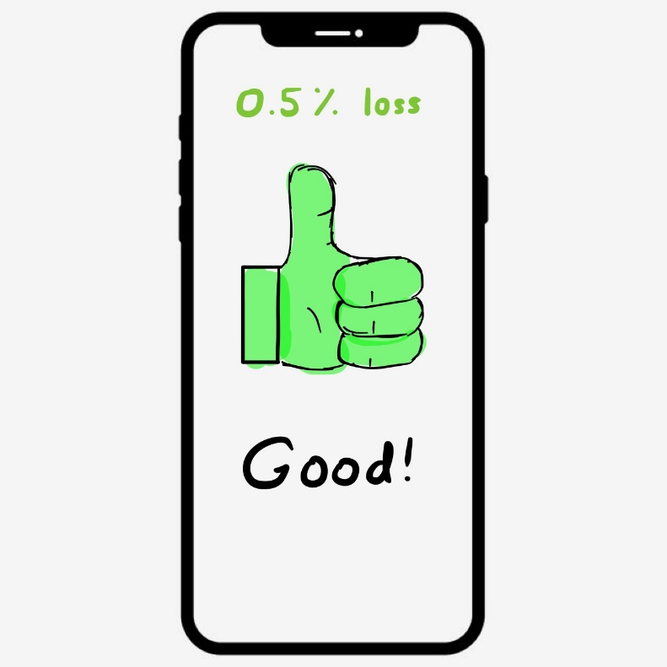
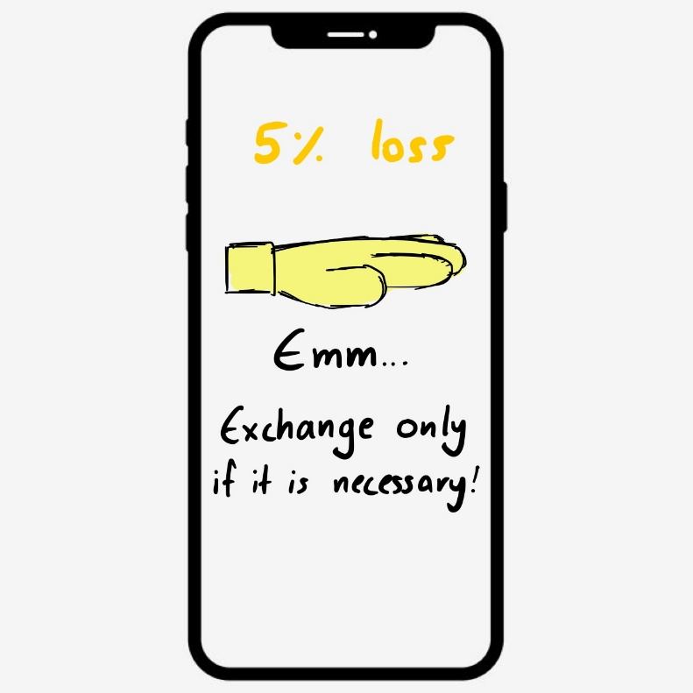
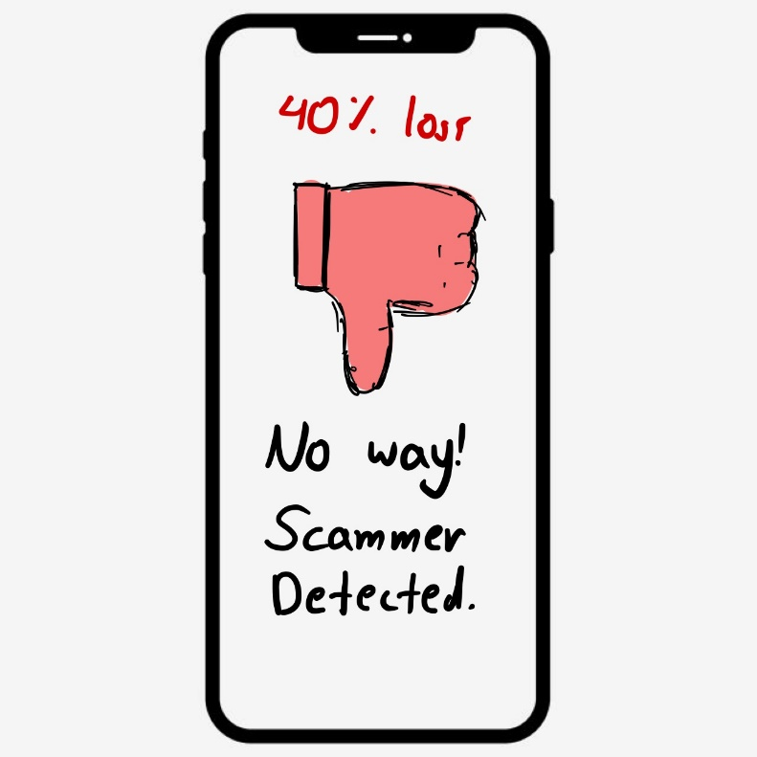
Prototype 3

Slide 8
Personas
(the average profile of our targets)

Slide 9
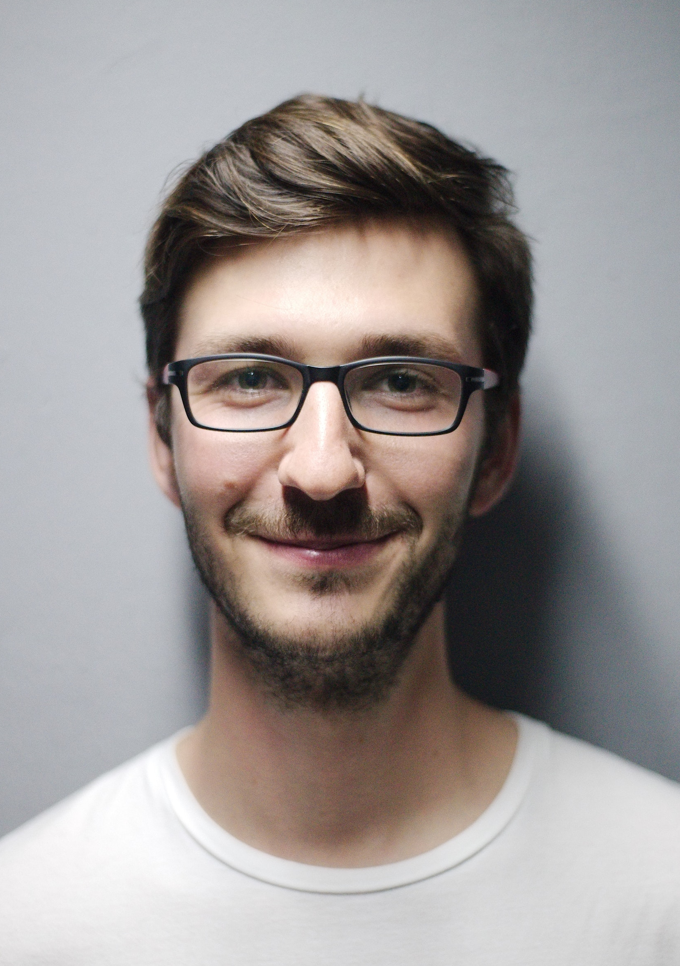
Matthew Adams
Matthew doesn’t have the economic comfort to book luxury hotels or rent cars. So, do not mistake him for a regular tourist.
He is the guy that would walk for 20 minutes just to find the cheapest souvenir shop in the city.
His relationship with technology is very good, but he also has high expectations from it. He believes that his smartphone can satisfy most of his travel needs (regarding maps, cheap communication, transportation etc).
Age: 20 years old
Studies: Engineering
Hobbies: Travelling

Slide 10
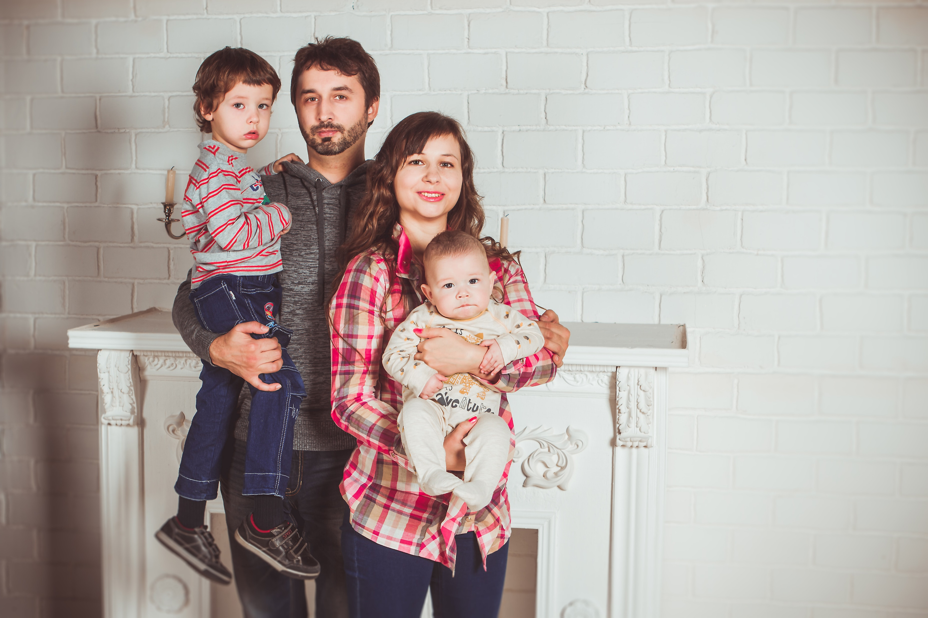
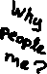
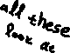
Shelby Family
This is the Shelby Family. It’s a middle class family with 2 kids.
John, the father, is working for at least 8 hours a day, in an office position. He really loves his family, even if it is making him more tired all the time. He has some experience with technology, but we wouldn’t really call him a “Guru of Tech”. When the new year steps in, the only thing that he is really looking forward to, it’s his family vacation in Greece.
Always by his side, his wife Marie. She works a part time job in order to help her husband, but she devotes most her time to their kids. Regarding technology, she always asks her husband to help her.
Their vacation time is around 10 days a year. And for them it is never enough. They are always look for new ways to manage their time better, and have more money to spend in activities with their kids.

Slide 11
Rectangular Model

Slide 12
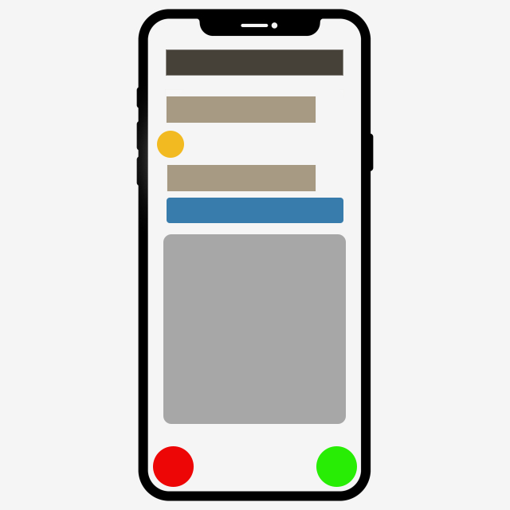
Rectangular Model

Slide 13
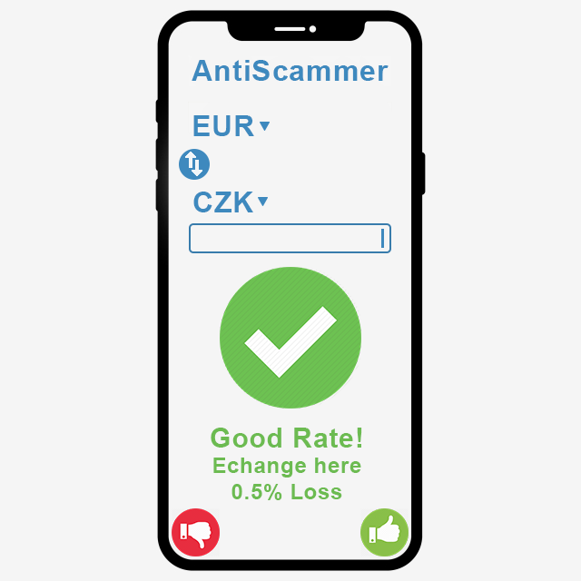
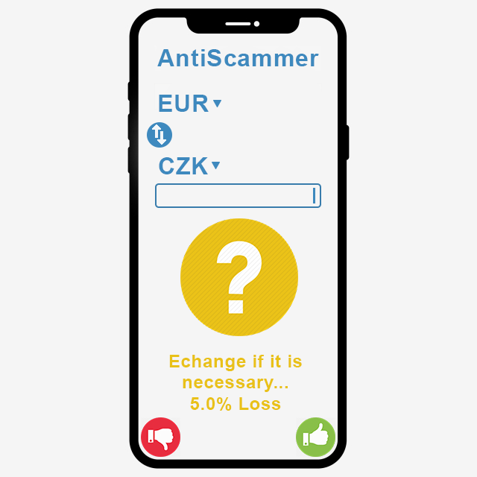
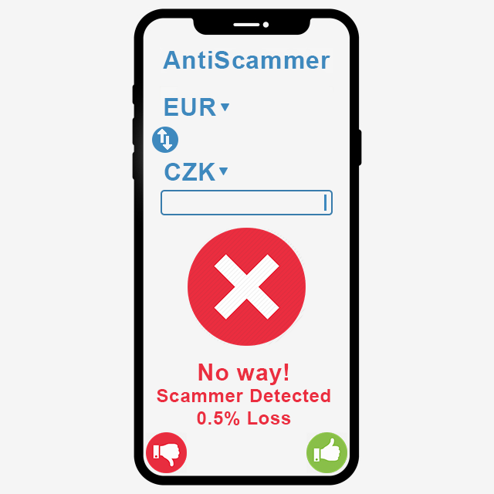
Prototype 4

Slide 14
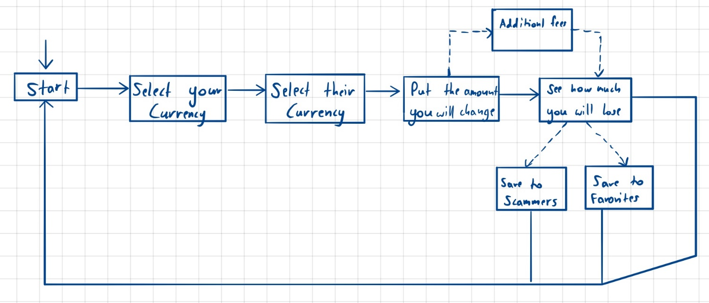
Conceptual Model

Slide 15
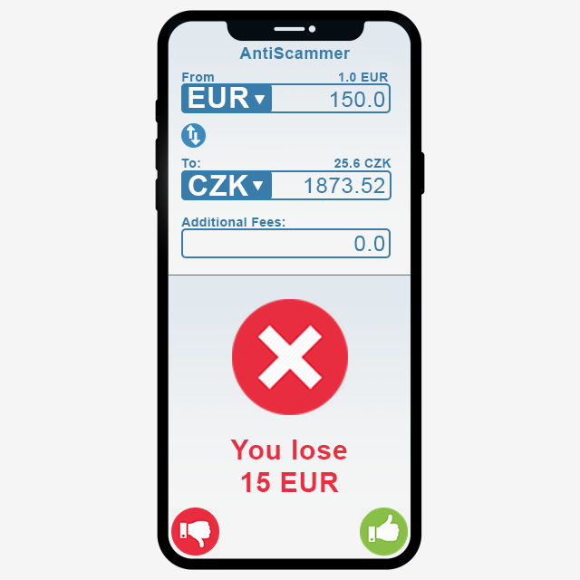
Prototype 5 (User has the freedom to choose)

Slide 16
? Questions ? - Answers -
“Where does the user find the saved places?”
“Can he see other people’s recommendations?”
“Would it help to give more info about what number to type into the input field?” / “Was it clear for the user what to enter in the text field?”
“There are a lot of emoticons in the prototypes. Seeing as how this project deals with financial issues, wouldn't a more "serious and business-like" approach work better than the current friendly one?”
“We will add a section where you can find the saved places.”
“Nice idea, but the problem is that different people have different recommendations. Something good for me, a businessman who doesn’t care giving some more money could be not as good for you who are a student with low budget. “
”Yes, will put a help button with some instructions on how to use the application.”
“Even the monsters can be friendly. You should use the Revolut app. An online bank supporting almost every currency of the world, managing millions of transactions per day and still when you spent too much money in a day the app tells you ‘Make it rain, today you have spent 2000 CZK’.“

Slide 17
? Questions ? - Answers -
“What are the like/dislike buttons for? Is it for rating the app?” / “What are the thumbs up and thumbs down buttons for?”
“How am I supposed to know the rate? Isn't the app supposed to tell me whether the offer that they make is good or not, according to the current currency market rate?” / “Is it better to show the optimal exchange rate or to calculate it from "I have" & "I will get" amounts?”
“What if the user needs to exchange the money, but the app is saying that loss is over 80%?”
“How the app chooses the place of exchange?”
“Of course not, that would be stupid. Is for like or dislike an exchange place.”
“The purpose of the app is to give you an advice if you should exchange money in the specific place or not. If you want to know the rate you can google it. The rates are for the economists. Us, the normal people we want to know just how much money we are going to lose.”
“The user should call the police to report the exchange place and definitely don’t exchange money there.”
“The app doesn’t choose any places”

Slide 18
Hard to understand questions
“How will look exchange place ranking GUI (map with places/list of exchange places or something else)?”
“How will users know in which direction the rate is? (e.g. 1:6 vs 6:1)”
Shouldn't user always know concrete amount of money that he is going to get?
How can you define what is/is not a good conversion? Maybe some research?

Slide 19
Outdated Questions
“Why do we have to select both currencies from different menu screens? I'd rather prefer to clearly see it all in one screen”
“Will the user get the result he wants in a quick enough way? Meaning - aren't there too many steps to the result?”

Slide 20
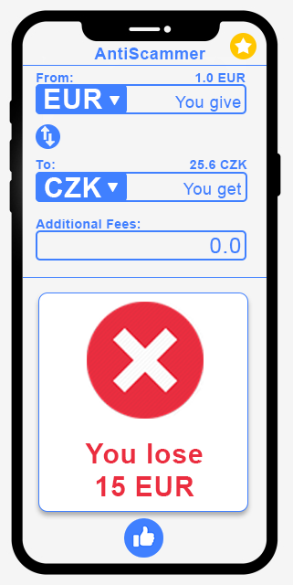
Prototype 6
Before Tests
After Tests

Slide 21
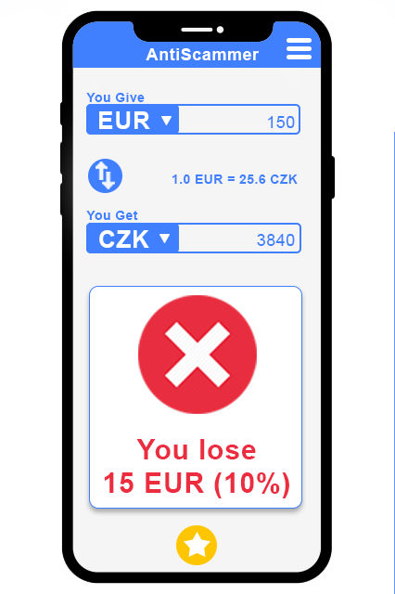
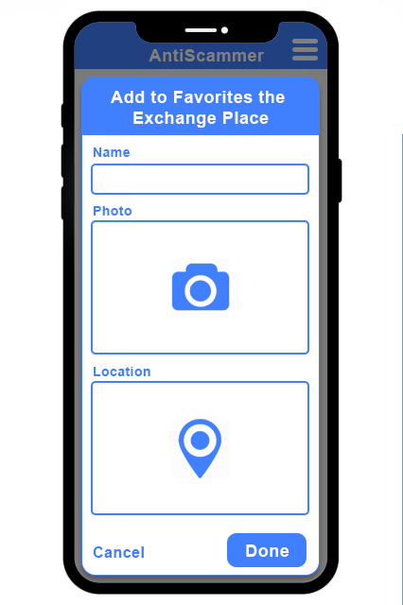
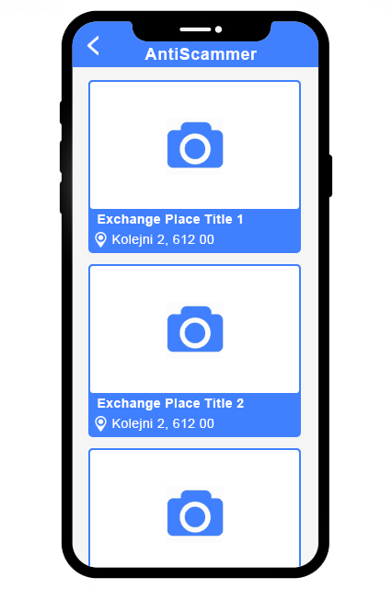
Prototype 7
Start Screen
Add to Favorites
Favorites Menu

Slide 22
Tests
Question:
What is the usage of this application?
Answer:
Check how mush you are going to lose if you exchange money with a specific rate.
Task 1:
We give you 26 CZK for 1 EUR, where are you going to put the data to check if it’s worth it?
Result 1:
Task 1 completed successfully
Task 2:
You liked the place and you want to add it to favorites.
Result 2:
The guy pressed the star button => Task 2 completed successfully

Slide 23
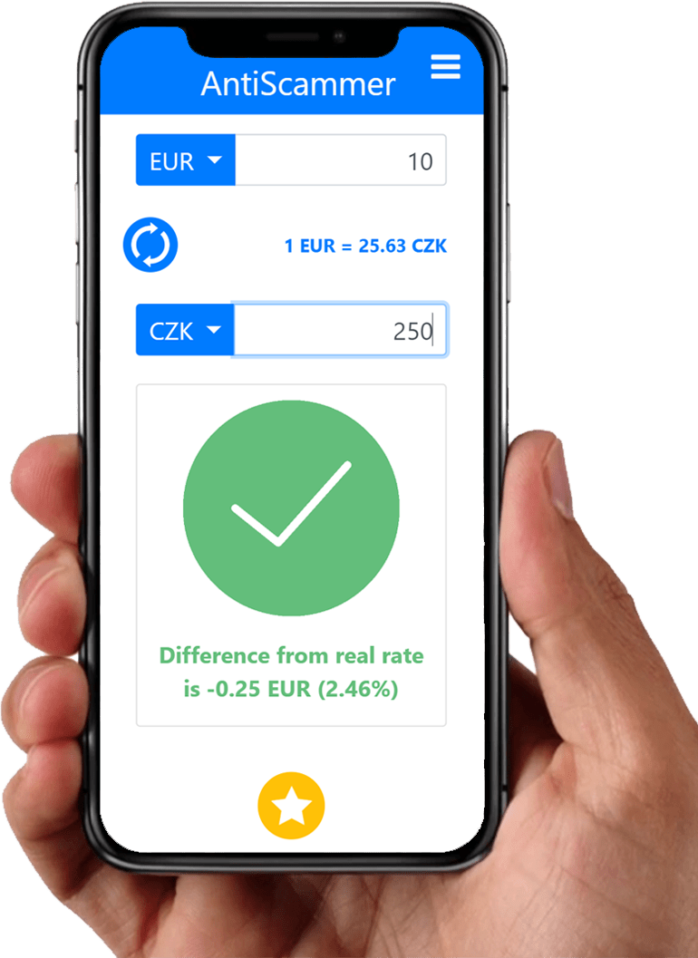
Alpha Version of AntiScammer (Real Photo)

Slide 24
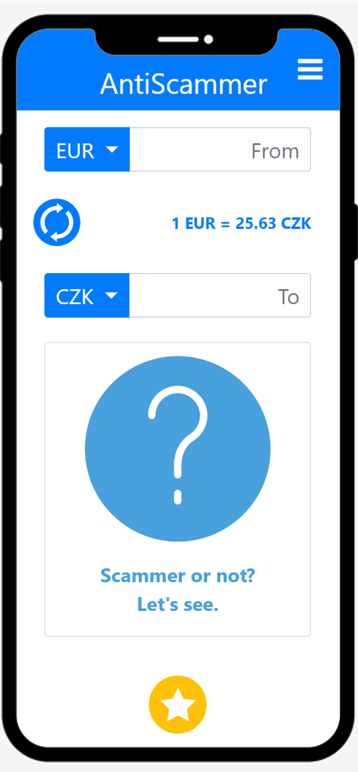
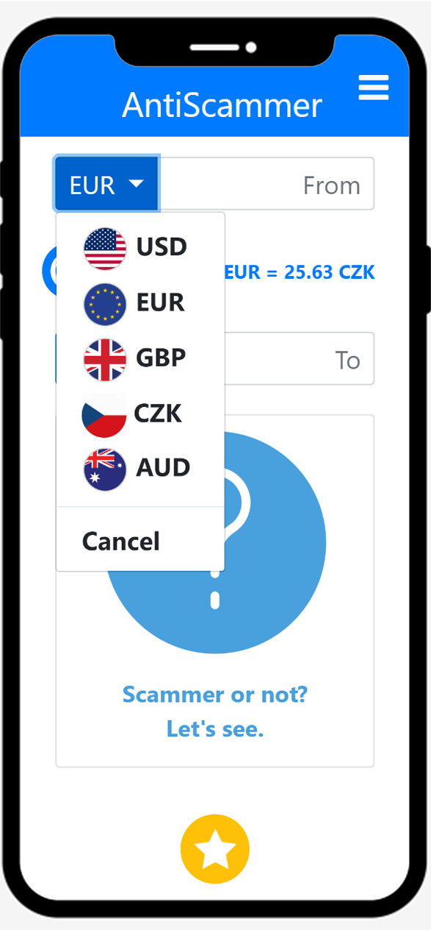
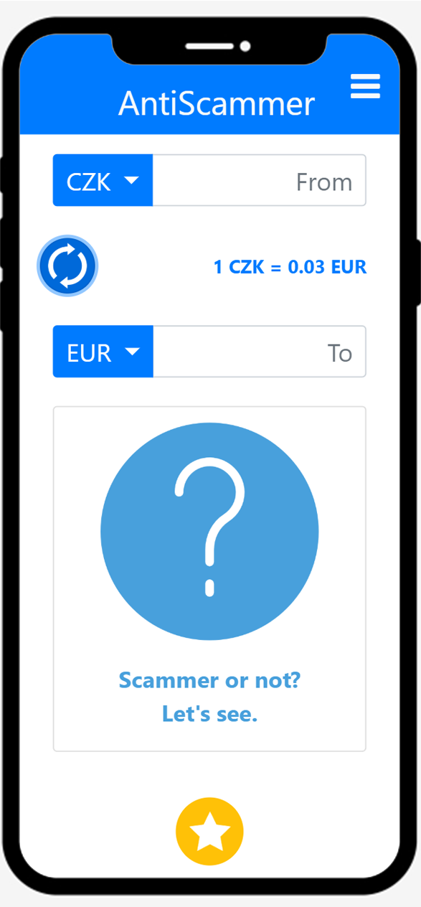
Alpha – Start Screen
Start Screen
Select Currency
Flip Currencies

Slide 25
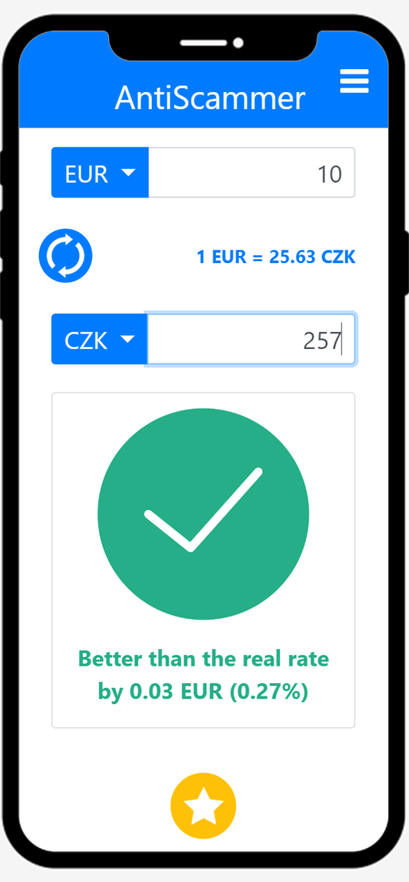
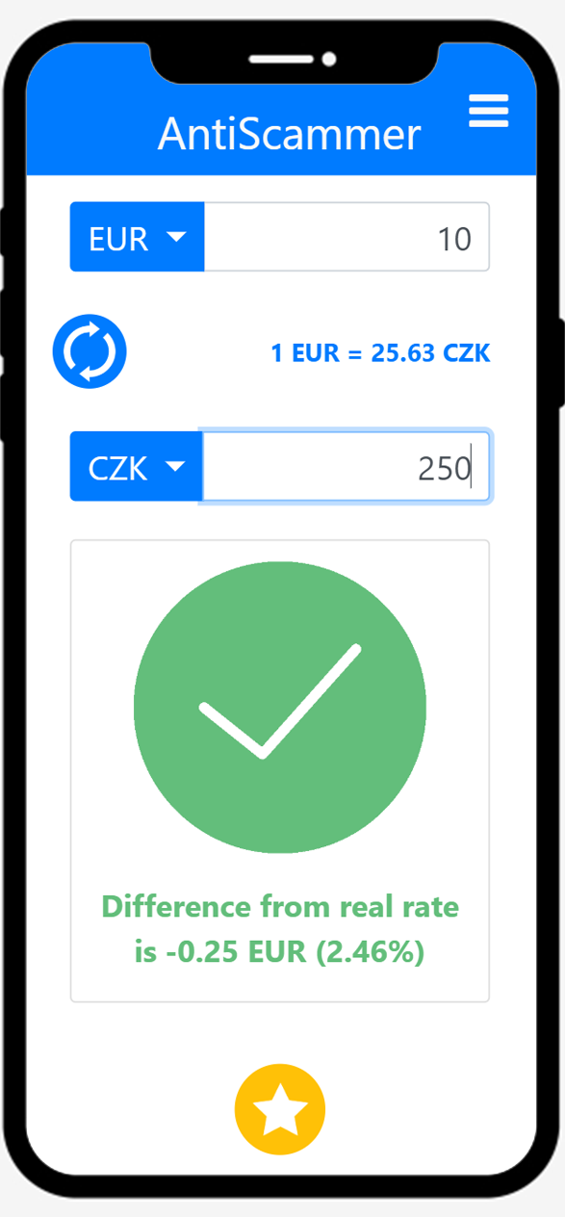
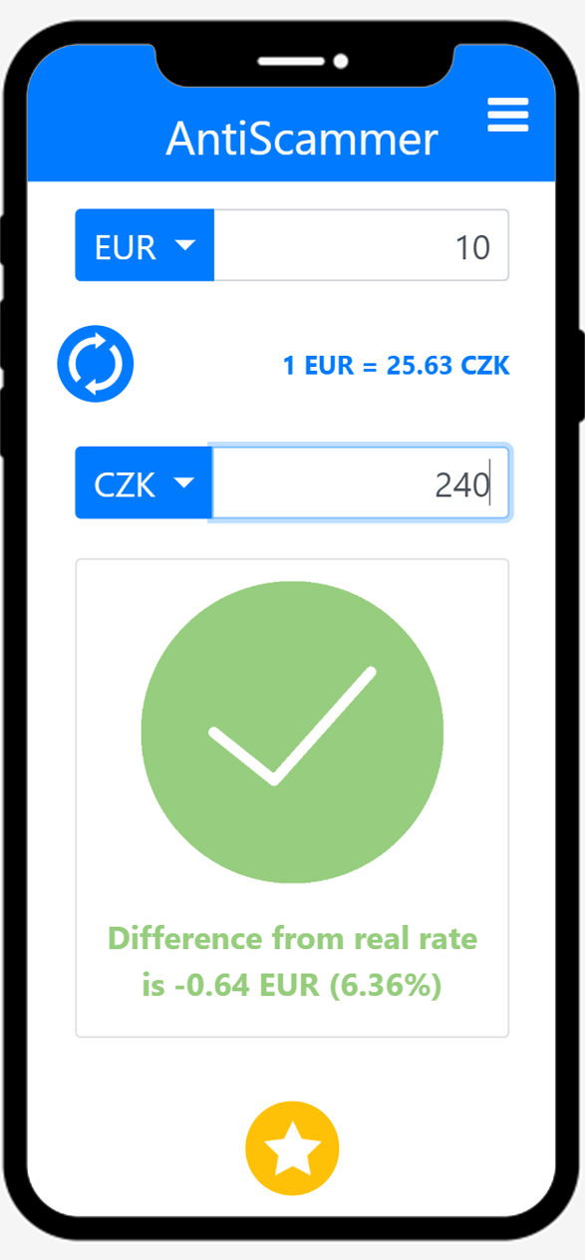
Alpha – Results 1
<0%
0-5%
5-10%

Slide 26
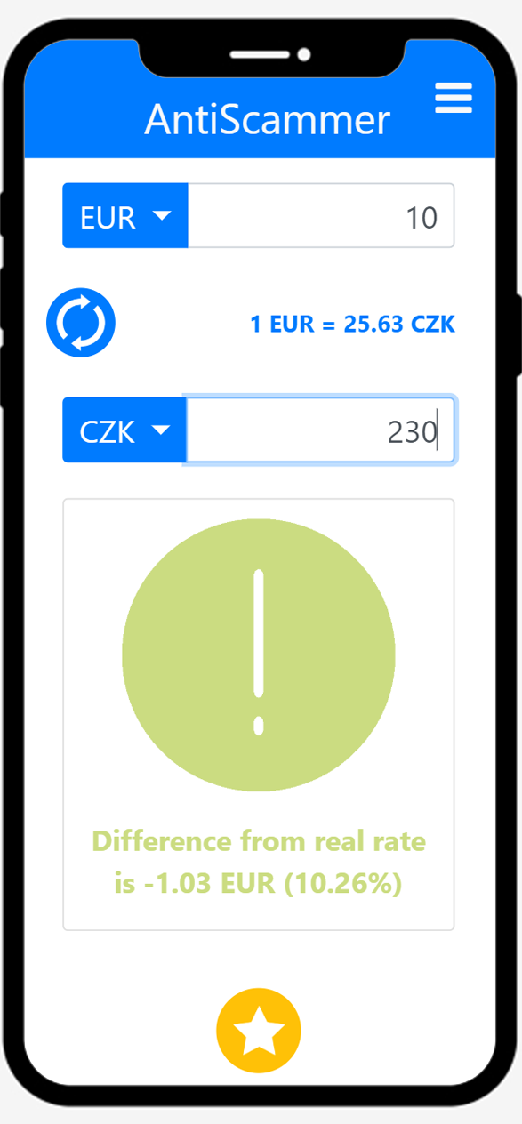
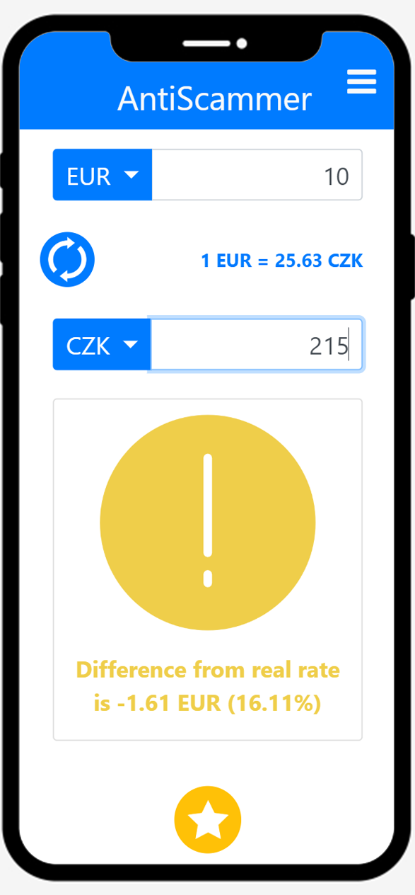
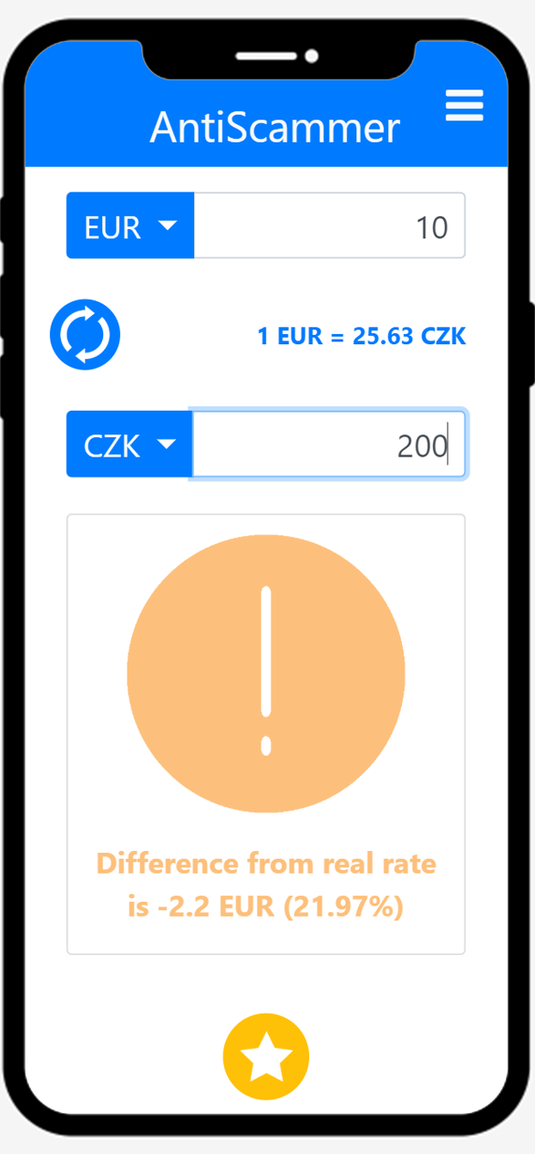
Alpha – Results 2
10-15%
15-20%
20-30%

Slide 27
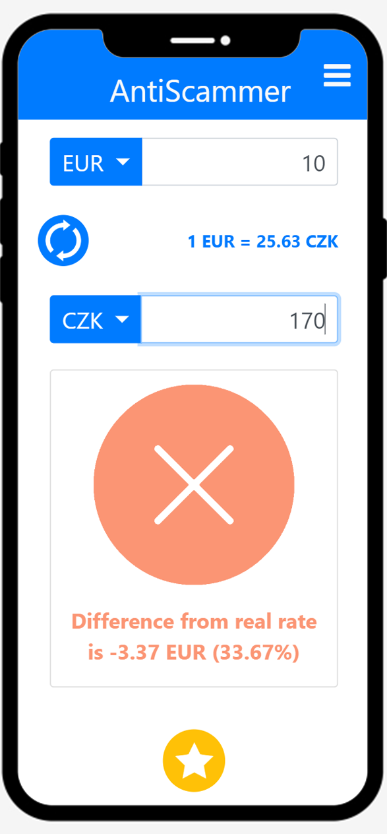
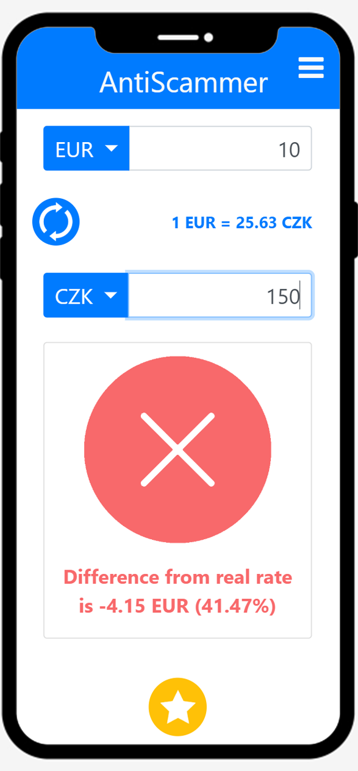

Alpha – Results 3
30-40%
40-50%
>50%

Slide 28
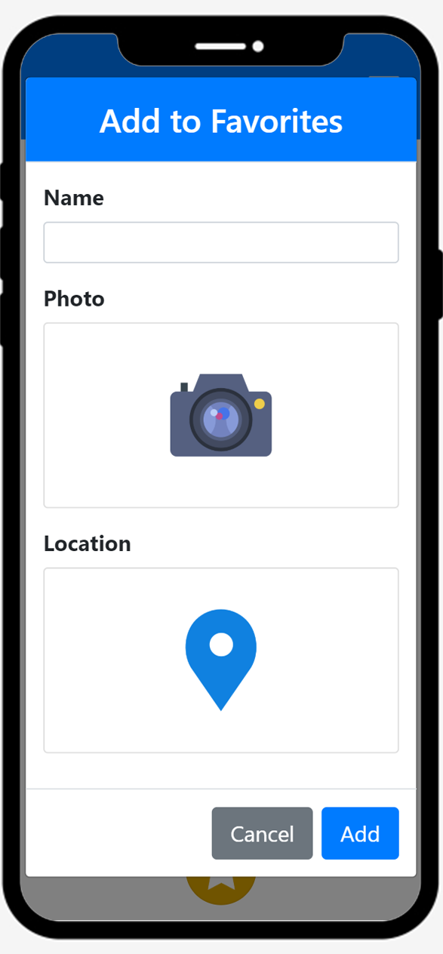
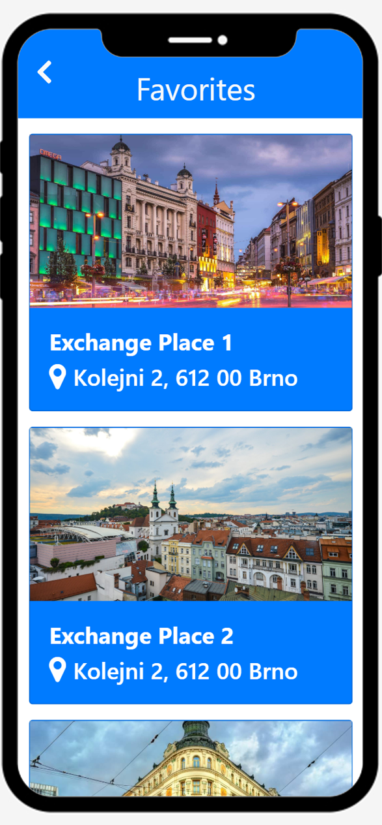
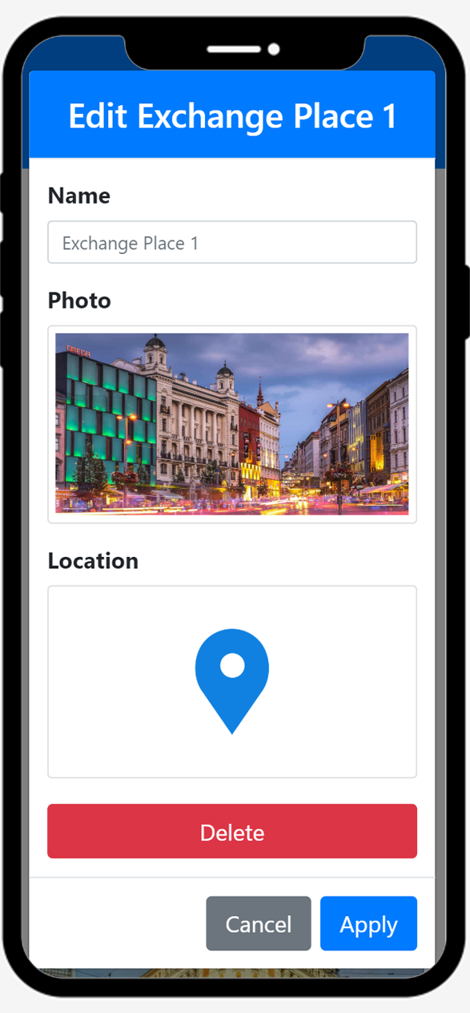
Alpha – Favorites
Add to Favorites
Favorites
Edit Favorites

